Slide 1
Applied Statistics, Probability theory and mathematical statistics
István Fazekas, Attila Barta, Sándor Pecsora
Special absolutely continuous distributions
”This work was supported by the construction EFOP-3.4.3-16-2016-00021. The project was supported by the European Union, co-financed by the European Social Fund.”

Slide 2
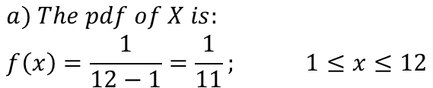
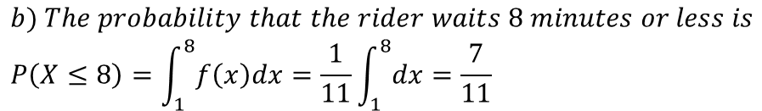
Exercise (Uniform distribution)
Let denote $X$ the waiting time at a bust stop. The waiting time at a bus stop is uniformly distributed between 1 and 12 minute. That is $X\sim U\left(1,12\right)$.
$$a) The pdf of X is: \\ f\left(x\right)=\frac{1}{12−1}=\frac{1}{11}; 1≤x≤12$$
$$b) The probability that the rider waits 8 minutes or less is \\ P\left(X≤8\right)=\int_{1}^{8}{f\left(x\right)dx}=\frac{1}{11}\int_{1}^{8}{dx}=\frac{7}{11}$$
$$c) The expected waiting time is 𝔼\left(X\right)=\frac{1+12}{2}=6.5$$
$$d) The variance waiting time is 𝔻^{2}\left(X\right)=\frac{{\left(12−1\right)}^{2}}{12}=\frac{121}{12}$$

Slide 3
Exercise (Uniform distribution Matlab solution)
n = 10^5;
x = rand(1,n)*11+1;
p = length(x(x<8))/n
x_mean = mean(x)
x_var = var(x)

Slide 4


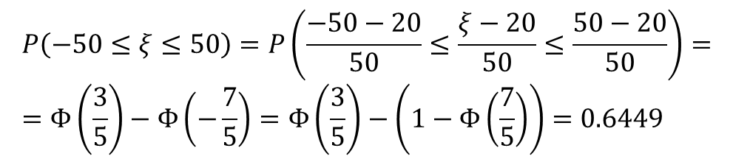
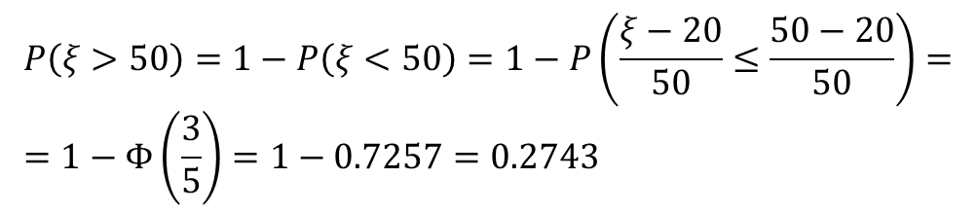
Exercise 13.5 (Normal distribution)
The air control informs the pilot of an aircraft about the altitude of the centre of the air corridor of height 100 metres where the aircraft should fly. The deviation, in metres, of the altitude of the aircraft from the given altitude is normally distributed with mean 20 and standard deviation 50. Find the probability that the aircraft flies under the air corridor, in the air corridor, above the air corridor.
$$ξ\sim 𝒩\left({20,50}^{2}\right)$$
100m
🛧
Above the air corridor
$$ξ$$
$$P\left(ξ>50\right)=1−P\left(ξ<50\right)=1−P\left(\frac{ξ−20}{50}≤\frac{50−20}{50}\right)= \\ =1−Φ\left(\frac{3}{5}\right)=1−0.7257=0.2743$$
In the air corridor
$$P\left(−50≤ξ≤50\right)=P\left(\frac{−50−20}{50}≤\frac{ξ−20}{50}≤\frac{50−20}{50}\right)= \\ =Φ\left(\frac{3}{5}\right)−Φ\left(−\frac{7}{5}\right)=Φ\left(\frac{3}{5}\right)−\left(1−Φ\left(\frac{7}{5}\right)\right)=0.6449$$

Slide 5
Exercise 13.5 (Normal distribution MATLAB solution)
1-normcdf(3/5)
normcdf(3/5)-(1-normcdf(7/5))
%%% Simulation
n = 10^5;
x = normrnd(20,50,[1,n]);
length(x(x>50))/n
length(x(x>-50&x<50))/n

Slide 6






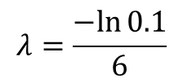




Exercise 13.13 (Exponential distribution)
The probability that at a filling station one has to wait more than 6 minutes for the service is 0.1. Given the waiting time is exponentially distributed find the probability that we are served in 3 minutes after arrival?
$ξ$- waiting time
$$P\left(ξ>6\right)=0.1$$
$$−λ∗6=\ln{0.1}$$
$P\left(ξ<3\right)=$?
$$λ=\frac{−ln{0.1}}{6}$$
$$P\left(ξ≤3\right)=1−e^{−λ∗3}=?$$
$$P\left(ξ≤3\right)=1−e^{− \frac{−ln{0.1}}{6}∗3}=0.68$$
$$P\left(ξ>6\right)=0.1$$
$$1−F\left(6\right)=0.1$$
$$1−\left(1−e^{−λ∗6}\right)=0.1$$
$$e^{−λ∗6}=0.1$$

Slide 7
Exercise 13.13 (Exponential distributionv MATLAB solution)
mu = log(10)/6;
expcdf(3,1/mu)
%%% Simulation
n = 10^5;
x = exprnd(1/mu,[1,n]);
length(x(x<3))/n

Slide 8
Literature
Ágnes Baran: Mathematics for engineers 1. (Laboratory slides)
Sándor Baran: Probability theory and statistics
Fazekas István: Valószínűségszámítás, Debreceni Egyetemi Kiadó, 2009
Fazekas István: Bevezetés a matematikai statisztikába, Debreceni Egyetemi Kiadó, 2009
Matlab examples: https://www.mathworks.com/help/examples.html

